Slide 1
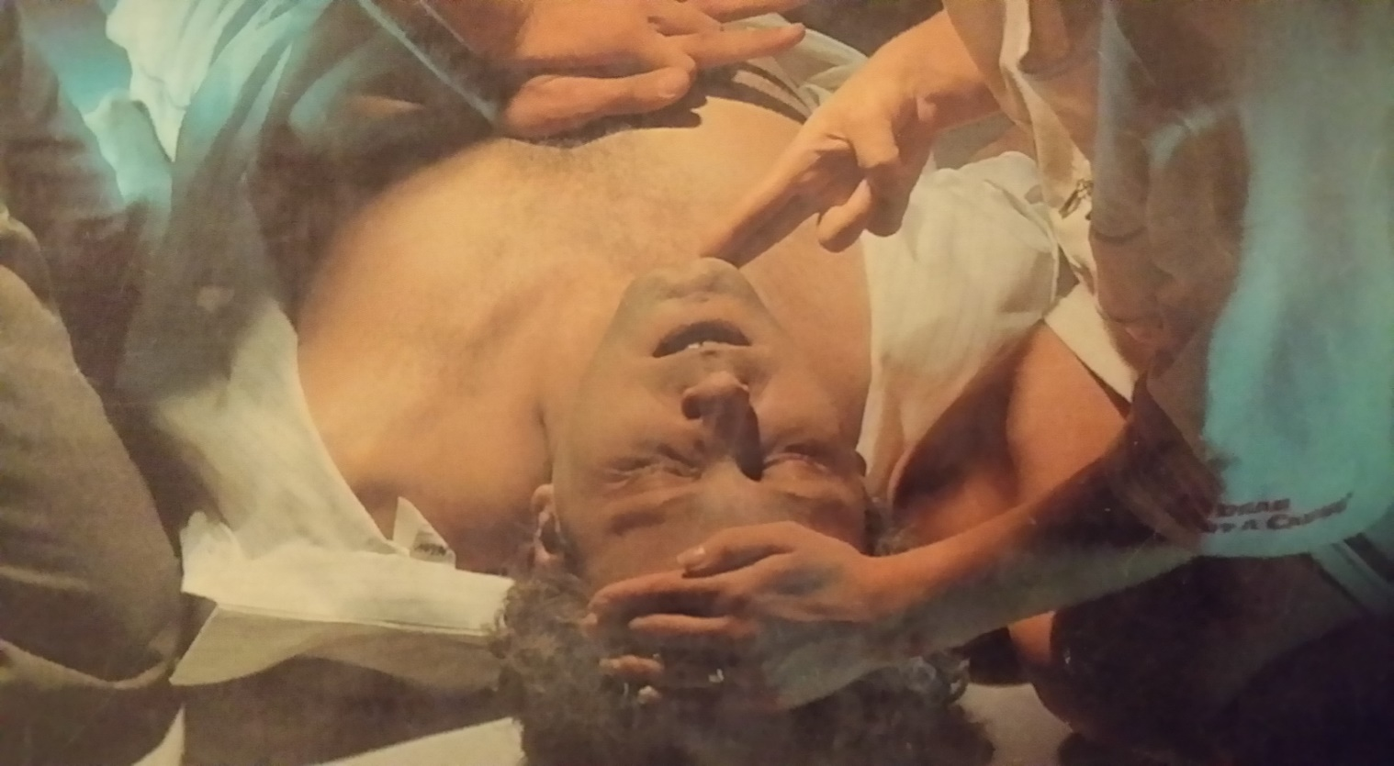
Rescue Breathing in Children and Infants
Behzad A. Sharabiani, MD
Tabriz Children Hospital

Slide 2
CPR:
BLS: Basic Life Support
احیای قلبی ریوی پایه) )
ACLS: Advanced Cardiac Life Support
(احیای قلبی ریوی پیشرفته)
Postresuscitation Life Support
(مراقبت پس از احیا)

Slide 3
BLS=ABC
A: Airway
B: Breathing
C: Circulation

Slide 4
ABC CAB

Slide 5
شایعترین علت خفگی در شیرخواران
آسپیراسیون مایعات ( و نه جامدات)

Slide 6
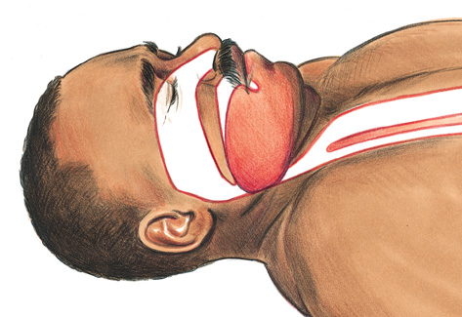
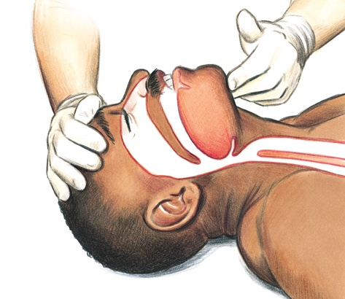
-Aباز كردن راه هوايي
شايع ترين علت انسداد راه هوايي در فرد بيهوش زبان بيمار است
قبل از باز كردن راه هوايي
بعد از باز كردن راه هوايي
12/9/2020
6
Notes:
6
ACLS providers should be aware that each person must display the skills of 1-rescuer adult CPR plus use of an AED.
Successful completion of the Heartsaver AED Skills Checklist is required for successful completion of the ACLS Provider Course.
This case is not the time to learn AED operation or CPR. Those skills are acquired before the course, during the skills station review, or during remediation at the end of the course.
This case should be quick and easy. The major purpose of this case is to allow providers to consider a very realistic and increasingly common situation: being asked to assist a passenger who has collapsed during a transoceanic commercial airliner flight.

Slide 7
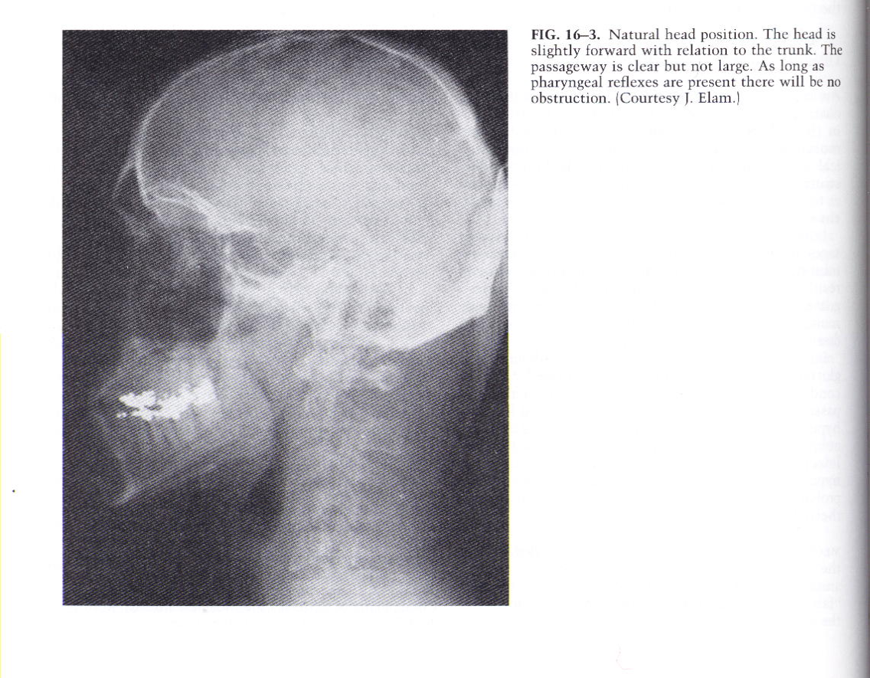

Slide 8
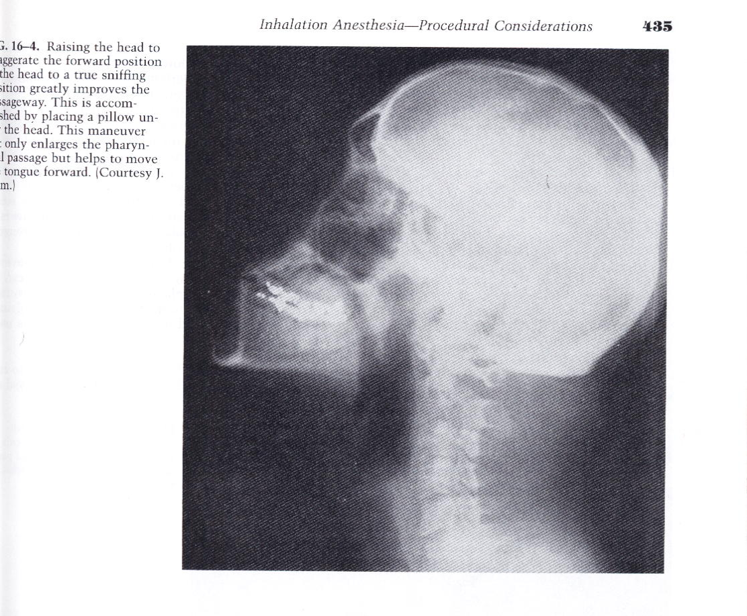

Slide 9
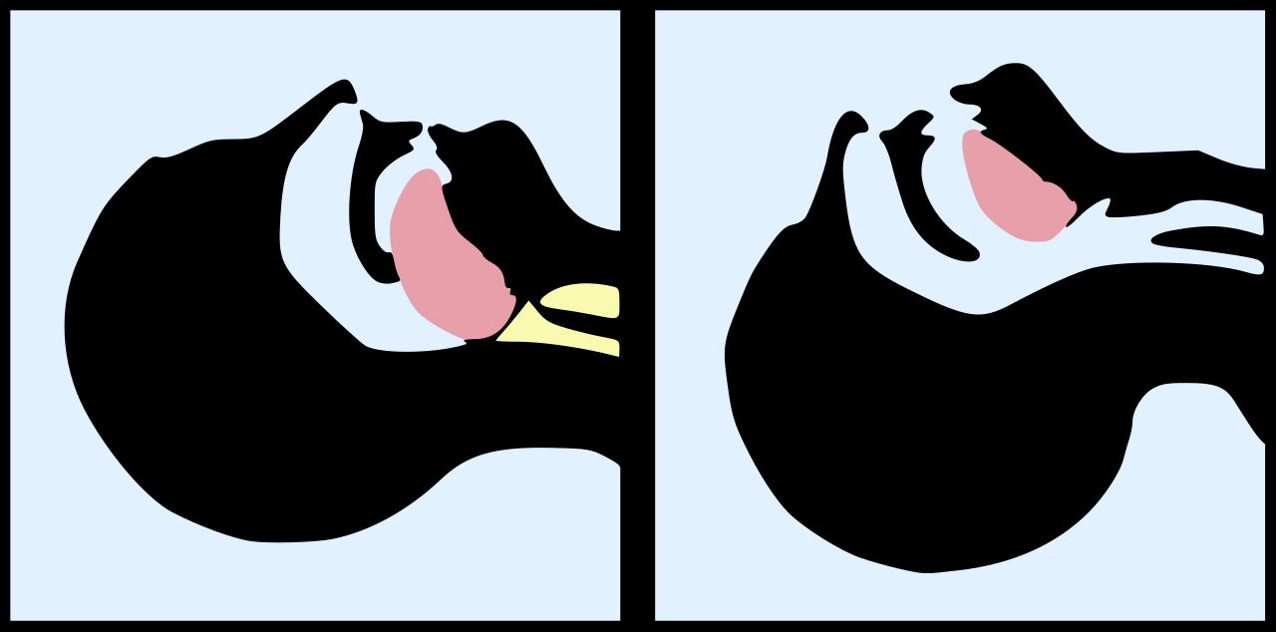
Hyperextention
Neutral

Slide 10
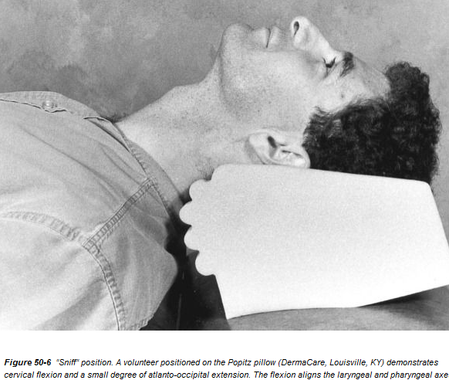
پوزیشن SNIFF

Slide 11
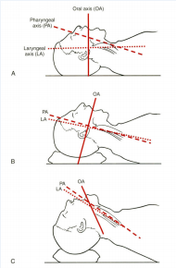
رابطه محورهای دهانی(OA)، حلقی(PA)، و حنجره ای(LA) با پوزیشن سرو گردن

Slide 12
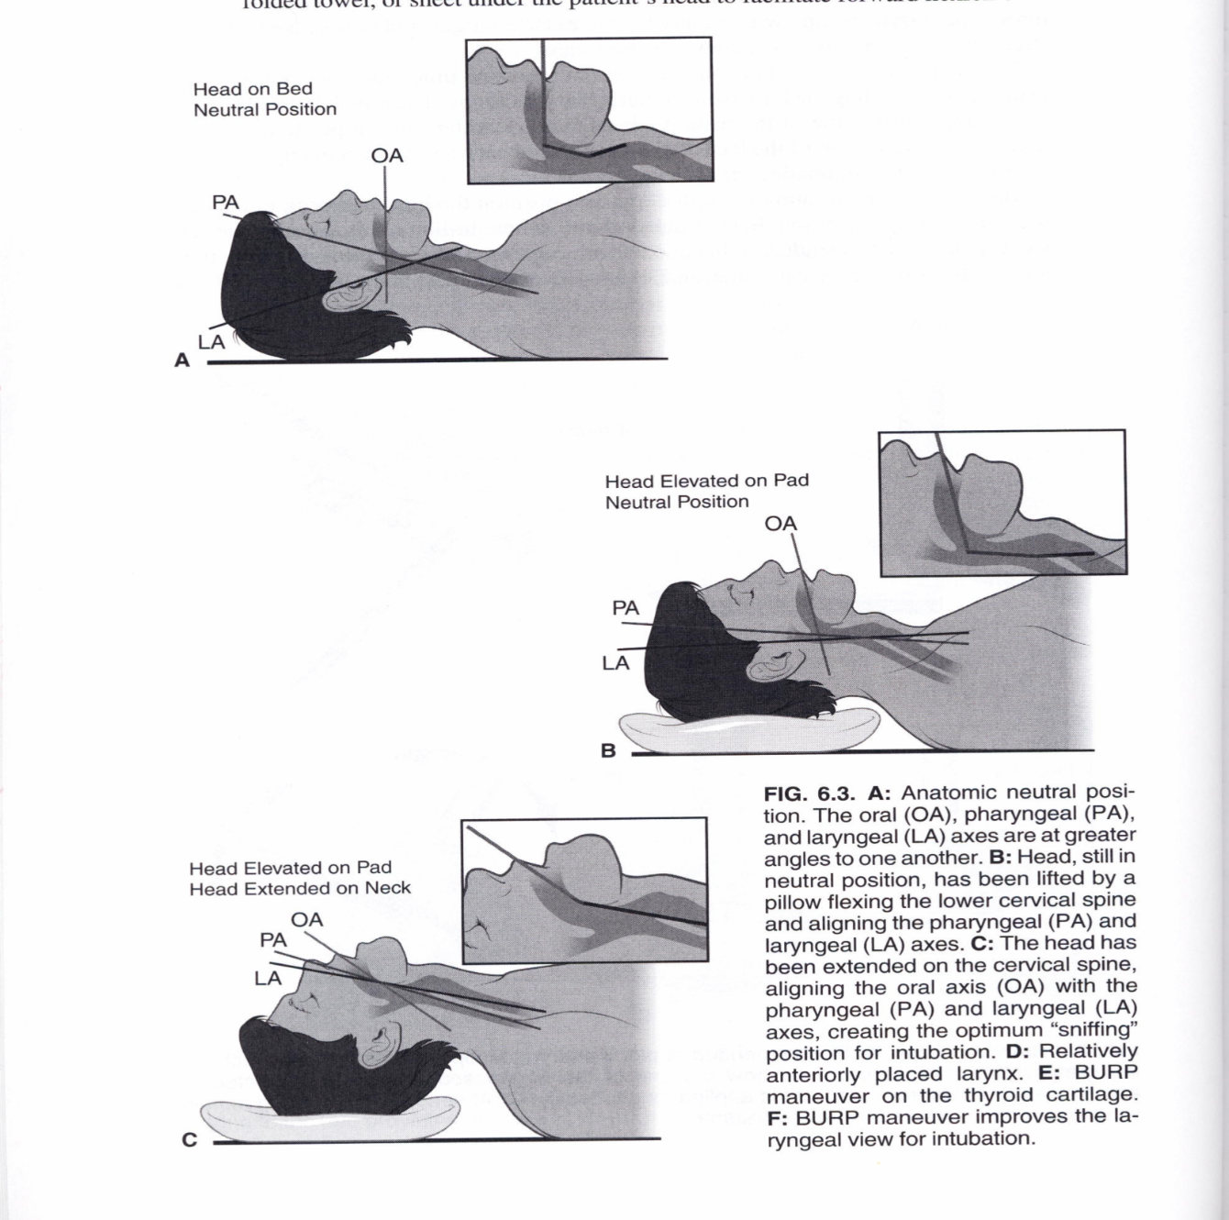
با گذاشتن بالشی در زیر سر، زاویه LA و PA را کم می کنیم. ( نزدیک کردن LA به PA ) با اکستانسیون گردن ، زاویه OA و PA کم می کنیم. ( نزدیک کردن OA به PA )

Slide 13
مانورهای باز کننده راه هوایی در کودک بیهوش
الف- در فردی بدون صدمه به نخاع گردنی:
مانور Head tilt- Chin lift یا مانور jaw thrust
ب- در فردی با صدمه به نخاع گردنی:
فقط مانور jaw thrust

Slide 14
مانور Head tilt- Chin lift

Slide 15
مانور jaw thrust

Slide 16
مانور jaw thrust

Slide 17
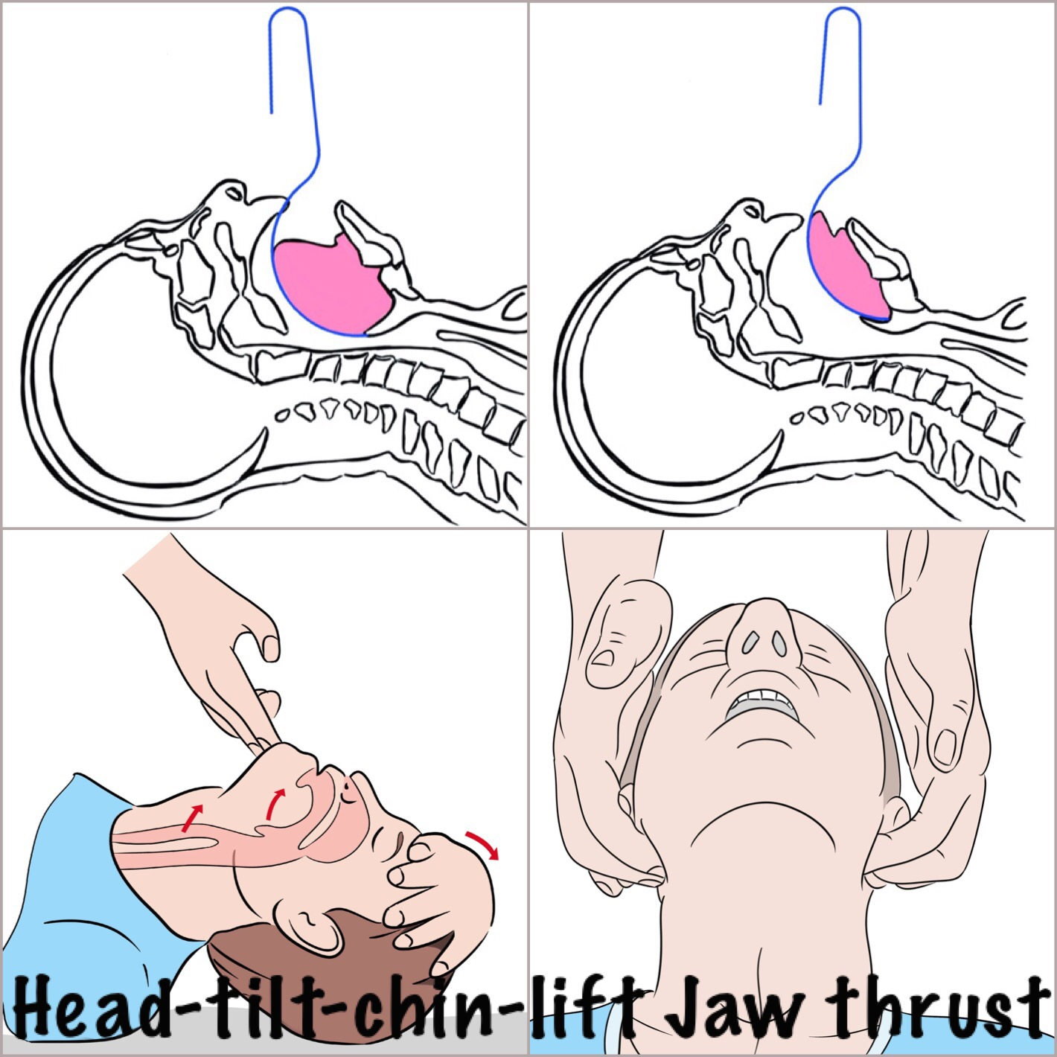
Control the tongue base – Control the airway

Slide 18
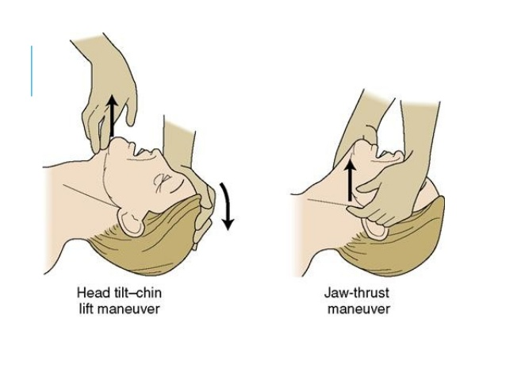

Slide 19
مانورهای باز کننده راه هوایی در کودک بیهوش
الف- در فردی بدون صدمه به نخاع گردنی:
مانور Head tilt- Chin lift یا مانور jaw thrust
ب- در فردی با صدمه به نخاع گردنی:
فقط مانور jaw thrust

Slide 20
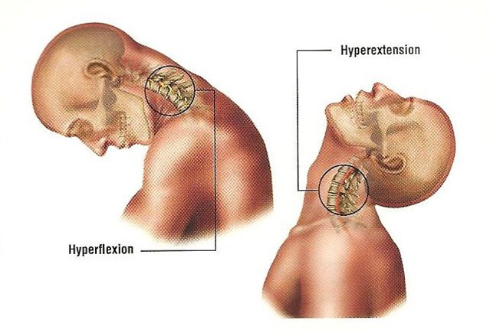
پرهیز از جابجایی گردن در موارد شک به وجود ترومای گردن

Slide 21
-Bارزيابي تنفس
گونه خود را مجاور دهان و بيني بيمار قرار دهيد
همزمان به حركات شكم و سينه بيمار دقت كنيد
با گونه خود جريان هوا، با گوش خود صداي تنفس و با چشمان خود حركات تنفس را ارزيابي كنيد
حداكثر در 10 ثانيه وجود يا عدم وجود تنفس را مشخص كنيد
12/9/2020
21
Notes:
21
ACLS providers should be aware that each person must display the skills of 1-rescuer adult CPR plus use of an AED.
Successful completion of the Heartsaver AED Skills Checklist is required for successful completion of the ACLS Provider Course.
This case is not the time to learn AED operation or CPR. Those skills are acquired before the course, during the skills station review, or during remediation at the end of the course.
This case should be quick and easy. The major purpose of this case is to allow providers to consider a very realistic and increasingly common situation: being asked to assist a passenger who has collapsed during a transoceanic commercial airliner flight.

Slide 22
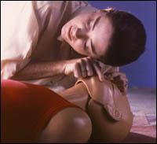
تكنيك ارزيابي تنفس
12/9/2020
22
Notes:
22
ACLS providers should be aware that each person must display the skills of 1-rescuer adult CPR plus use of an AED.
Successful completion of the Heartsaver AED Skills Checklist is required for successful completion of the ACLS Provider Course.
This case is not the time to learn AED operation or CPR. Those skills are acquired before the course, during the skills station review, or during remediation at the end of the course.
This case should be quick and easy. The major purpose of this case is to allow providers to consider a very realistic and increasingly common situation: being asked to assist a passenger who has collapsed during a transoceanic commercial airliner flight.

Slide 23
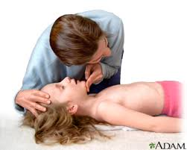
با چشمانتان به قفسه سینه نگاه کنید : برای دیدن حرکات تنفسی با گوشتان گوش کنید : برای شنیدن صدای تنفسی با پوستتان لمس کنید : برخورد جریان هوای بازدمی را
برای ارزیابی تنفس ازسه حستان کمک بگیرید

Slide 24
[B]تنفس دادن به بیمار(تهویه)
1- تهویه دهان به دهان
2- تهویه دهان به بینی
3-تهویه دهان به ماسک
4- تهویه با ماسک وبگ
5- تهویه با لوله تراشه وبگ
6- تهویه با لوله تراشه و ونتیلاتور

Slide 25
تنفس دهان به دهان
دادن تنفس كمكي
دقت به بسته نگه داشتن بینی کودک حین اعمال تنفس
Notes:
25
ACLS providers should be aware that each person must display the skills of 1-rescuer adult CPR plus use of an AED.
Successful completion of the Heartsaver AED Skills Checklist is required for successful completion of the ACLS Provider Course.
This case is not the time to learn AED operation or CPR. Those skills are acquired before the course, during the skills station review, or during remediation at the end of the course.
This case should be quick and easy. The major purpose of this case is to allow providers to consider a very realistic and increasingly common situation: being asked to assist a passenger who has collapsed during a transoceanic commercial airliner flight.

Slide 26
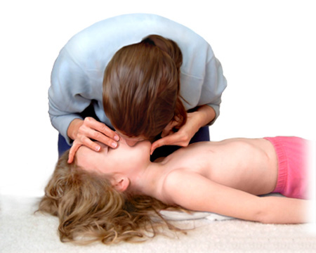
تنفس دهان به دهان
دادن تنفس كمكي
دقت به بسته نگه داشتن بینی کودک حین اعمال تنفس
Notes:
26
ACLS providers should be aware that each person must display the skills of 1-rescuer adult CPR plus use of an AED.
Successful completion of the Heartsaver AED Skills Checklist is required for successful completion of the ACLS Provider Course.
This case is not the time to learn AED operation or CPR. Those skills are acquired before the course, during the skills station review, or during remediation at the end of the course.
This case should be quick and easy. The major purpose of this case is to allow providers to consider a very realistic and increasingly common situation: being asked to assist a passenger who has collapsed during a transoceanic commercial airliner flight.

Slide 27
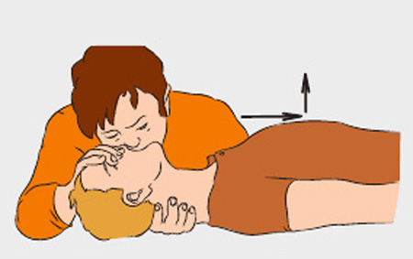
تنفس دهان به دهان
دادن تنفس كمكي
دقت به بسته نگه داشتن بینی ، پوزیشن دهی و استفاده از حواس
Notes:
27
ACLS providers should be aware that each person must display the skills of 1-rescuer adult CPR plus use of an AED.
Successful completion of the Heartsaver AED Skills Checklist is required for successful completion of the ACLS Provider Course.
This case is not the time to learn AED operation or CPR. Those skills are acquired before the course, during the skills station review, or during remediation at the end of the course.
This case should be quick and easy. The major purpose of this case is to allow providers to consider a very realistic and increasingly common situation: being asked to assist a passenger who has collapsed during a transoceanic commercial airliner flight.

Slide 28
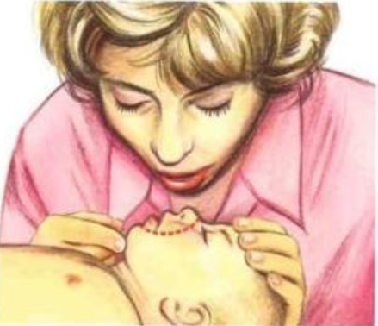
تنفس دهان به بینی
دادن تنفس كمكي
در شیرخواران بهتر است دهان احیا کننده همزمان دهان وبینی شیرخوار را بپوشاند، ولی اگر دهان احیا کننده به قدر کافی بزرگ نباشد، باید دهان خود را روی بینی طفل قرار داده و از راه بینی نفس دهد و دهان شیرخوار را بسته نگه دارد.
Notes:
28
ACLS providers should be aware that each person must display the skills of 1-rescuer adult CPR plus use of an AED.
Successful completion of the Heartsaver AED Skills Checklist is required for successful completion of the ACLS Provider Course.
This case is not the time to learn AED operation or CPR. Those skills are acquired before the course, during the skills station review, or during remediation at the end of the course.
This case should be quick and easy. The major purpose of this case is to allow providers to consider a very realistic and increasingly common situation: being asked to assist a passenger who has collapsed during a transoceanic commercial airliner flight.

Slide 29
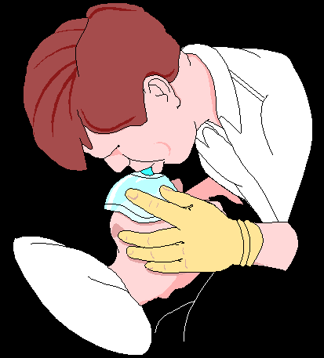
تنفس دهان به ماسک
دادن تنفس كمكي
دقت به نحوه صحیح گرفتن ماسک و پوزیشن دهی به بیمار
Notes:
29
ACLS providers should be aware that each person must display the skills of 1-rescuer adult CPR plus use of an AED.
Successful completion of the Heartsaver AED Skills Checklist is required for successful completion of the ACLS Provider Course.
This case is not the time to learn AED operation or CPR. Those skills are acquired before the course, during the skills station review, or during remediation at the end of the course.
This case should be quick and easy. The major purpose of this case is to allow providers to consider a very realistic and increasingly common situation: being asked to assist a passenger who has collapsed during a transoceanic commercial airliner flight.

Slide 30
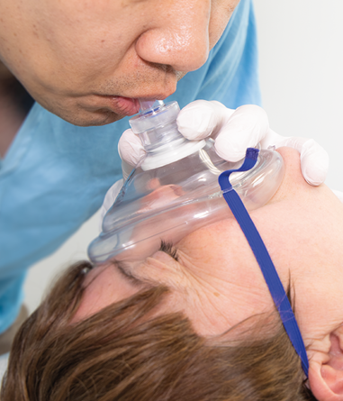
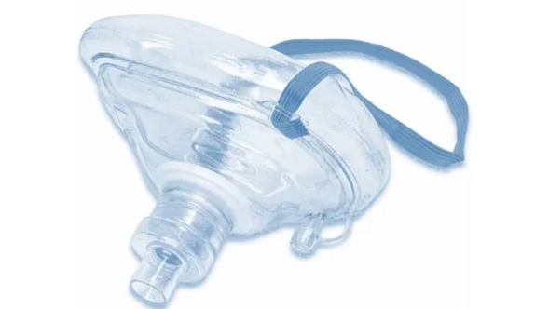
تنفس دهان به ماسک
دادن تنفس كمكي
دقت به نحوه صحیح گرفتن ماسک
Notes:
30
ACLS providers should be aware that each person must display the skills of 1-rescuer adult CPR plus use of an AED.
Successful completion of the Heartsaver AED Skills Checklist is required for successful completion of the ACLS Provider Course.
This case is not the time to learn AED operation or CPR. Those skills are acquired before the course, during the skills station review, or during remediation at the end of the course.
This case should be quick and easy. The major purpose of this case is to allow providers to consider a very realistic and increasingly common situation: being asked to assist a passenger who has collapsed during a transoceanic commercial airliner flight.

Slide 31
اگر فرد هشيار نيست و نفس نمي كشد :
2 نفس پشت سر هم به بيمار بدهيد
در صورتي كه تنفس دهان به دهان مي دهيد با يك دست خود، بيني بيمار را مسدود كنيد و با دست ديگر پيشاني را به عقب فشار داده ( یا چانه را به بالا فشار دهید ) و راه هوايي را باز نگه داريد
حجمي از هوا كه باعث بالا آمدن ريه ها شود كافي است
هر تنفس را در يك ثانيه بدهيد
در فاصله 2 تنفس يك ثانيه مجال دهيد تا هواي داده شده خارج شود
12/9/2020
31
Notes:
31
ACLS providers should be aware that each person must display the skills of 1-rescuer adult CPR plus use of an AED.
Successful completion of the Heartsaver AED Skills Checklist is required for successful completion of the ACLS Provider Course.
This case is not the time to learn AED operation or CPR. Those skills are acquired before the course, during the skills station review, or during remediation at the end of the course.
This case should be quick and easy. The major purpose of this case is to allow providers to consider a very realistic and increasingly common situation: being asked to assist a passenger who has collapsed during a transoceanic commercial airliner flight.

Slide 32
شرایط تهویه ایده ال
بقدری که سینه بلند شود واز پر هوائی هم اجتناب شود.(حدود -10ml/kg6)
تا حد امکان از ورود هوا به معده پرهیز شود.(خطرریگورژیتاسیون و آسپیراسیون)
بعد از هر دم فرصت خروج هوا وبازدم هم داده شود(جهت پرهیز ازاحتباس هوا وپر بادی ریه ها)(یک ثانیه)
سرعت تهویه 20-30/min تنفس باشد( هر 3-2 ثانیه یک تنفس)

Slide 33
هماهنگی بین تنفس و ماساژ سینه
- سرعت ماساژسینه :
100-120/min
- سرعت تنفس :
8-10/min
- نسبت تنفس به ماساژ در احیاء یک نفره :
2 به 30
نسبت تنفس به ماساژ در احیاء دونفره :
2 به 15

Slide 34
هماهنگی بین تنفس و ماساژ سینه
یک واحد احیاء معادل یک سیکل 2 به 30=حدودا 24 ثانیه
5 واحد احیا معادل 2 دقیقه
طول هر فشار سینه = 0/5 ثانیه در 30= 15
مدت رفع فشار = 0/2 ثانیه در 30 = 6
مدت دم = 1 ثانیه در 2 = 2
مدت بازدم = 0/5 ثانیه در 2= 1
جمع کل زمان یک سیکل = 24 ثانیه

